Slide 1
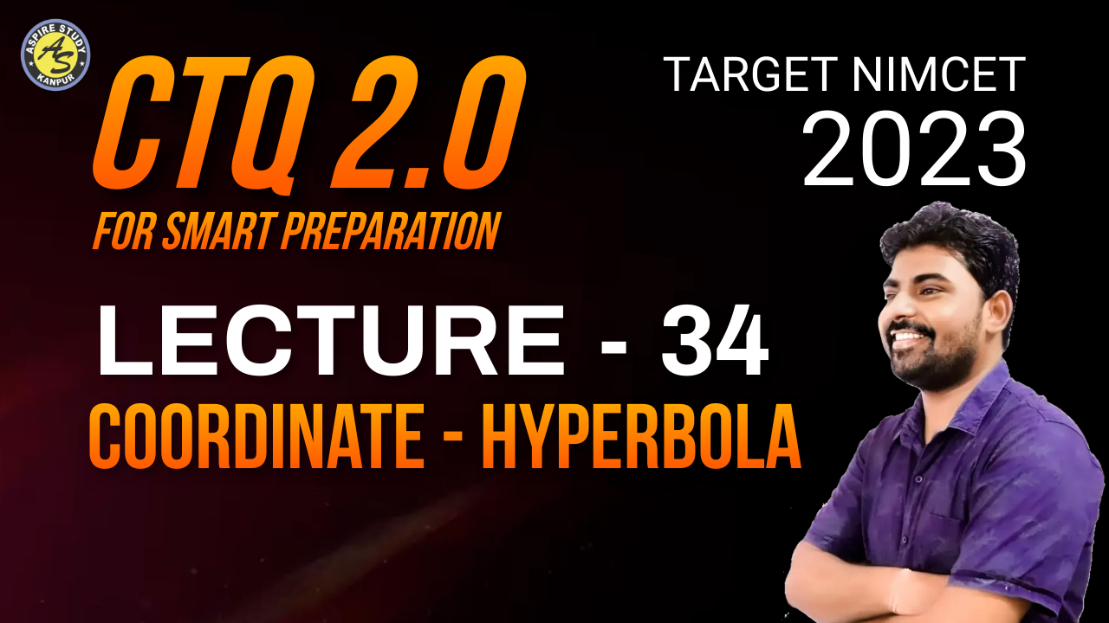

Slide 2
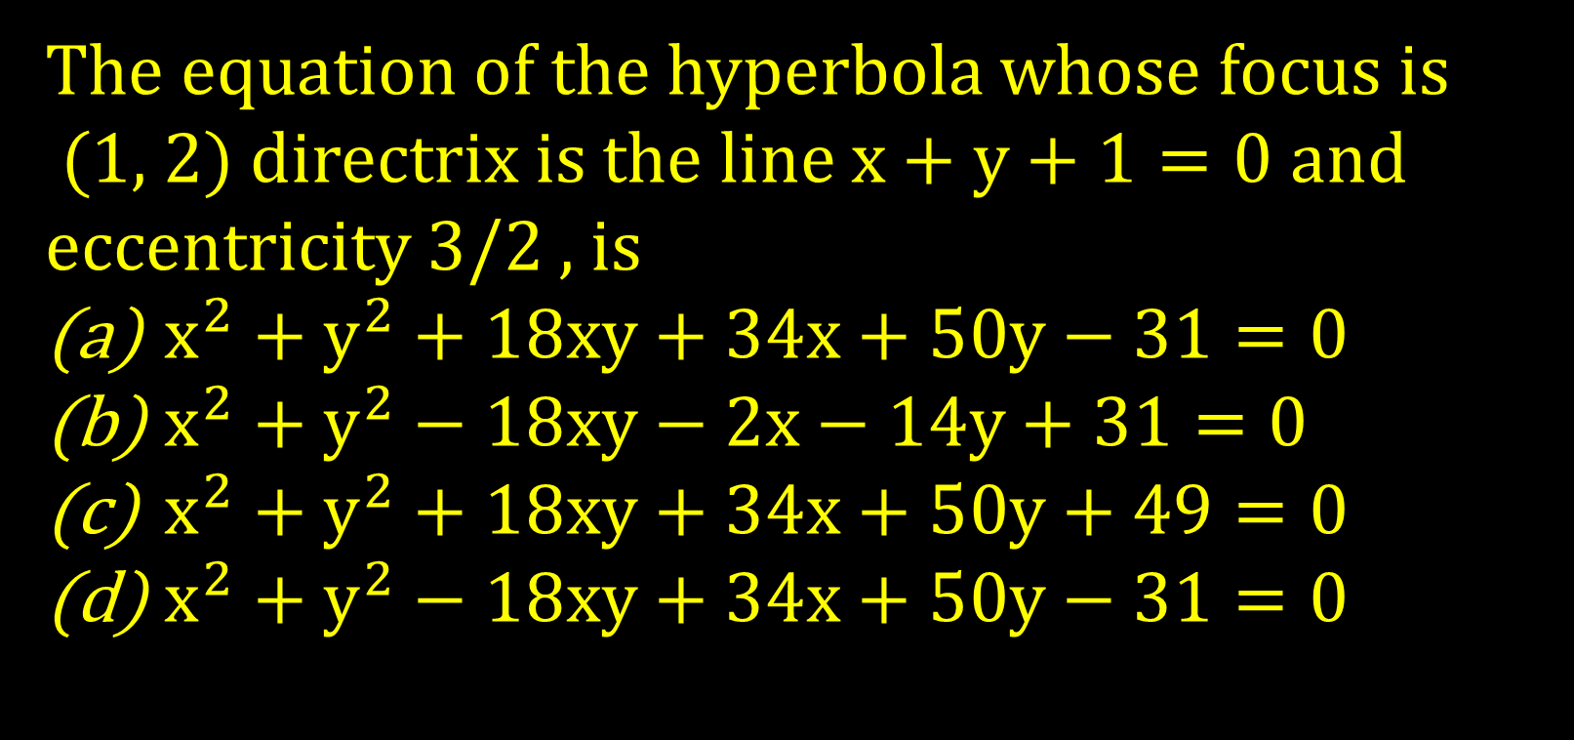
The equation of the hyperbola whose focus is
(1, 2) directrix is the line $x+y+1=0$ and eccentricity 3/2 , is
$x^{2}+y^{2}+18xy+34x+50y−31=0$
$x^{2}+y^{2}−18xy−2x−14y+31=0$
$x^{2}+y^{2}+18xy+34x+50y+49=0$
$x^{2}+y^{2}−18xy+34x+50y−31=0$

Slide 3
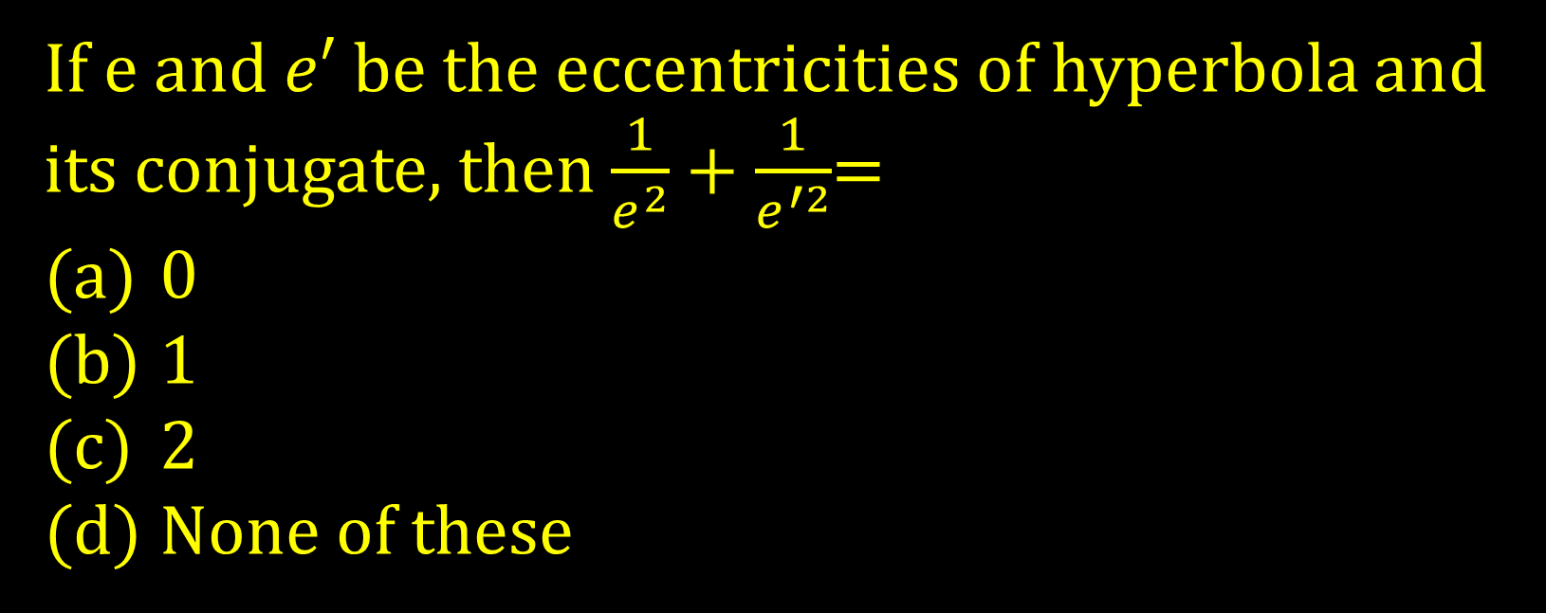
If e and $e′$be the eccentricities of hyperbola and its conjugate, then $\frac{1}{e^{2}}+\frac{1}{e^{′2}}$=
0
1
2
None of these

Slide 4
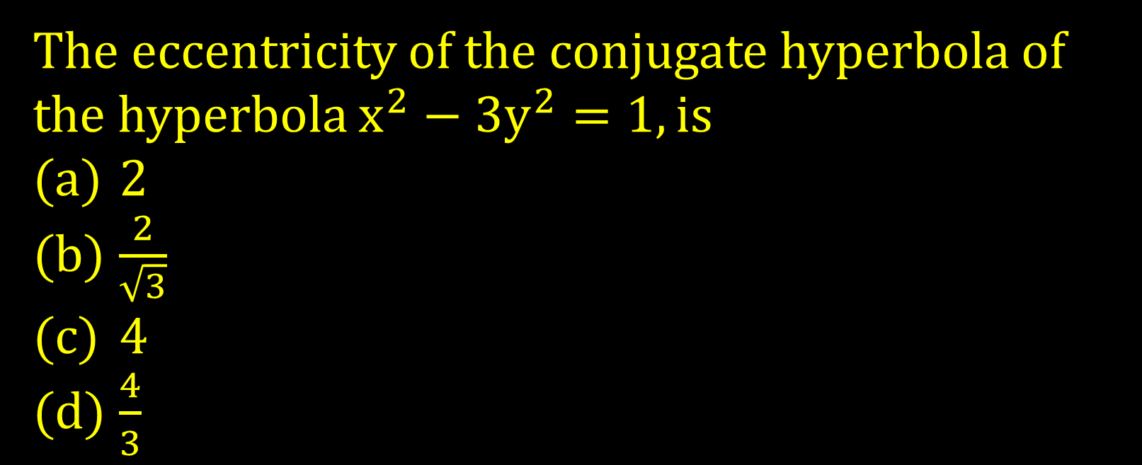
The eccentricity of the conjugate hyperbola of the hyperbola $x^{2}−3y^{2}=1,is$
2
$\frac{2}{\sqrt{3}}$
4
$\frac{4}{3}$

Slide 5
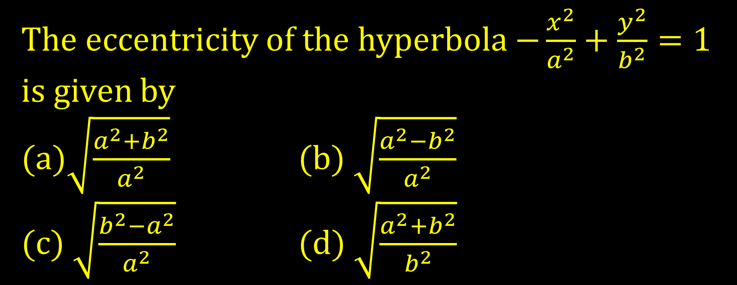
The eccentricity of the hyperbola $−\frac{x^{2}}{a^{2}}+\frac{y^{2}}{b^{2}}=1$ is given by
(a)$\sqrt{\frac{a^{2}+b^{2}}{a^{2}}}$ (b) $\sqrt{\frac{a^{2}−b^{2}}{a^{2}}}$
(c) $\sqrt{\frac{b^{2}−a^{2}}{a^{2}}}$ (d) $\sqrt{\frac{a^{2}+b^{2}}{b^{2}}}$

Slide 6
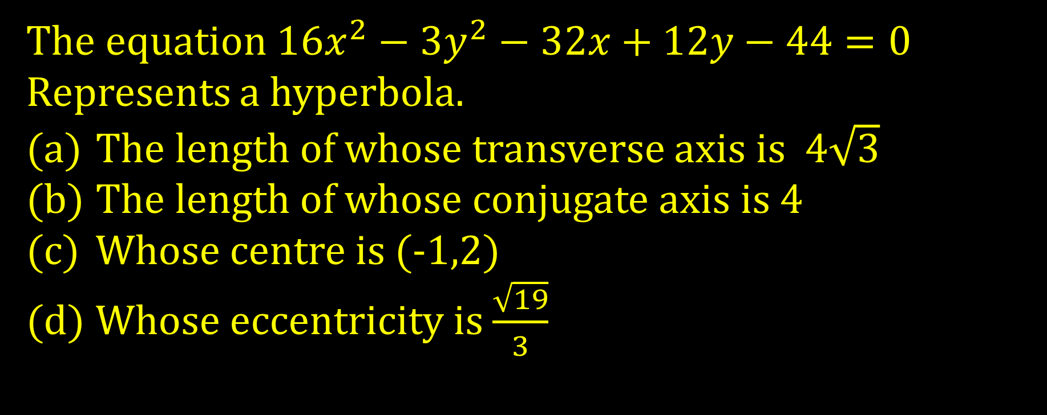
The equation $16x^{2}−3y^{2}−32x+12y−44=0$
Represents a hyperbola.
The length of whose transverse axis is $4\sqrt{3}$
The length of whose conjugate axis is 4
Whose centre is (-1,2)
Whose eccentricity is $\frac{\sqrt{19}}{3}$

Slide 7
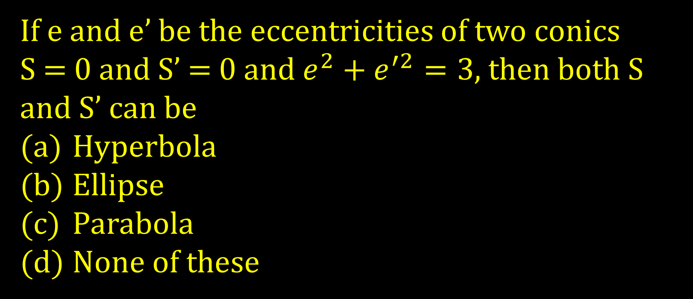
If e and e’ be the eccentricities of two conics
S = 0 and S’ = 0 and $e^{2}+e^{′2}=3$, then both S and S’ can be
Hyperbola
Ellipse
Parabola
None of these

Slide 8
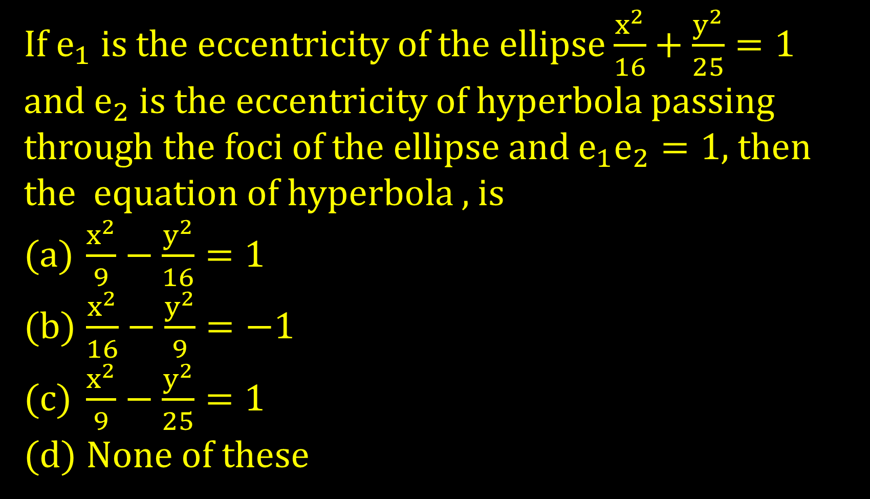
If $e_{1}$ is the eccentricity of the ellipse $\frac{x^{2}}{16}+\frac{y^{2}}{25}=1$ and $e_{2}$is the eccentricity of hyperbola passing through the foci of the ellipse and $e_{1}e_{2}=1$, then the equation of hyperbola , is
$\frac{x^{2}}{9}−\frac{y^{2}}{16}=1$
$\frac{x^{2}}{16}−\frac{y^{2}}{9}=−1$
$\frac{x^{2}}{9}−\frac{y^{2}}{25}=1$
None of these

Slide 9
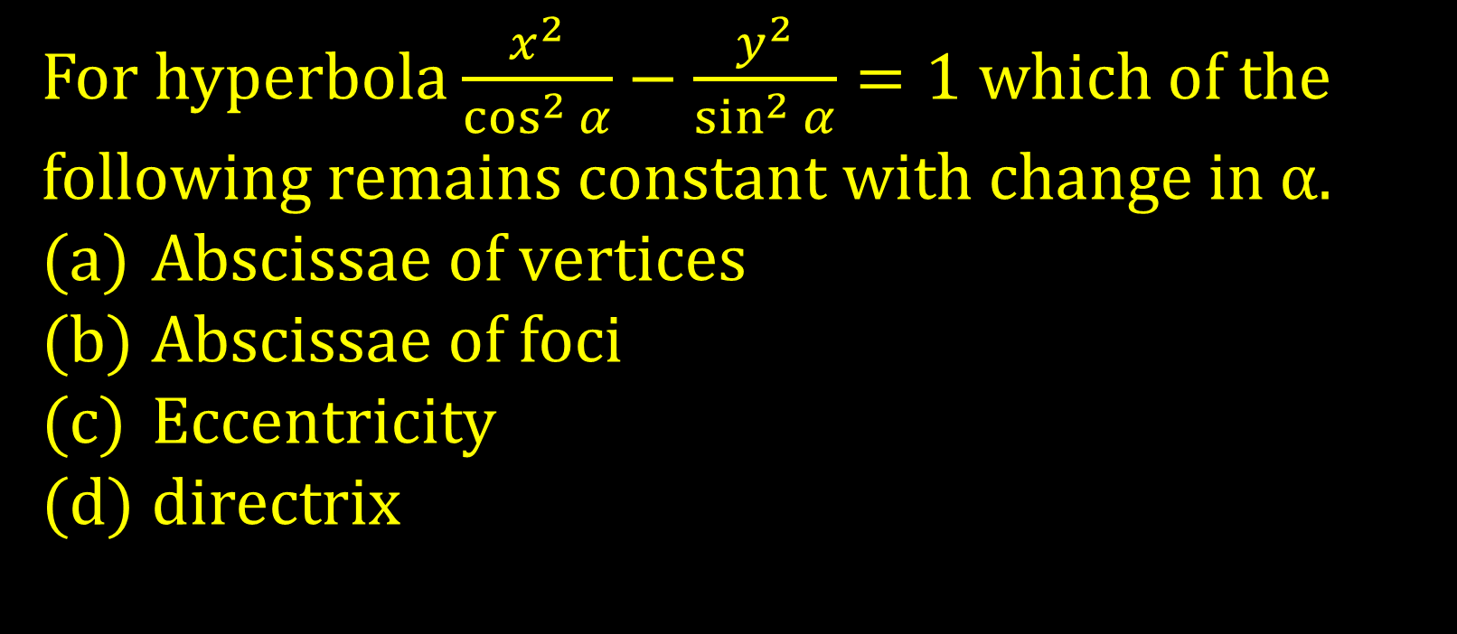
For hyperbola $\frac{x^{2}}{\cos^{2}{α}}−\frac{y^{2}}{\sin^{2}{α}}=1$ which of the following remains constant with change in $\text{α}.$
Abscissae of vertices
Abscissae of foci
Eccentricity
directrix

Slide 10
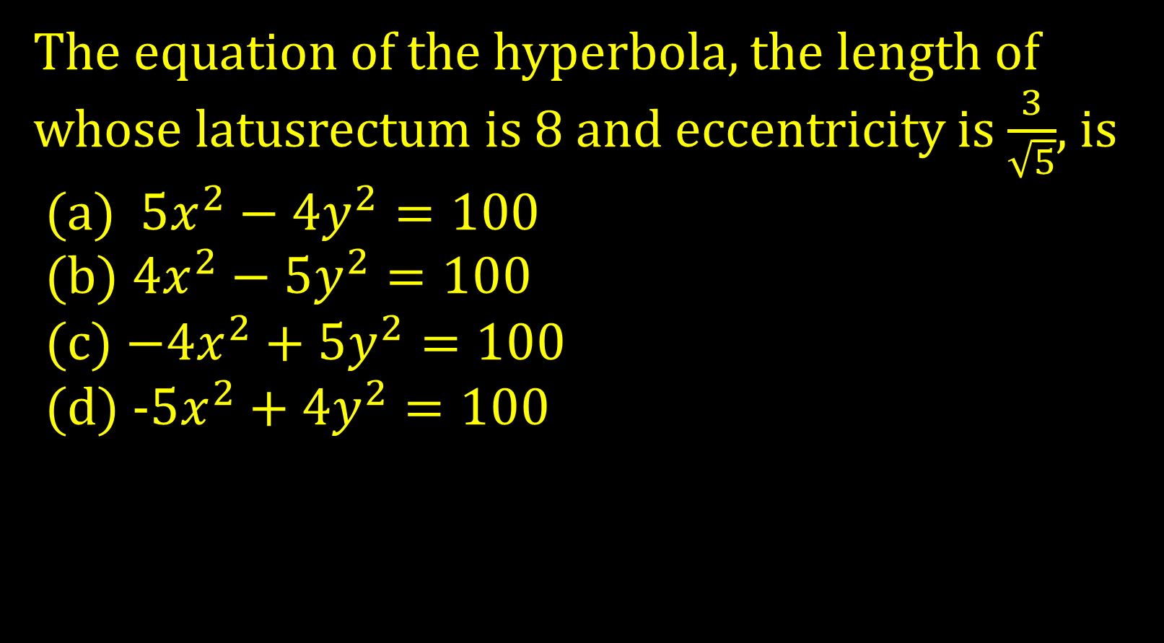
The equation of the hyperbola, the length of whose latusrectum is 8 and eccentricity is $\frac{3}{\sqrt{5}}$, is
(a) $5x^{2}−4y^{2}=100$
(b) $4x^{2}−5y^{2}=100$
(c) $−4x^{2}+5y^{2}=100$
(d) -$5x^{2}+4y^{2}=100$

Slide 11
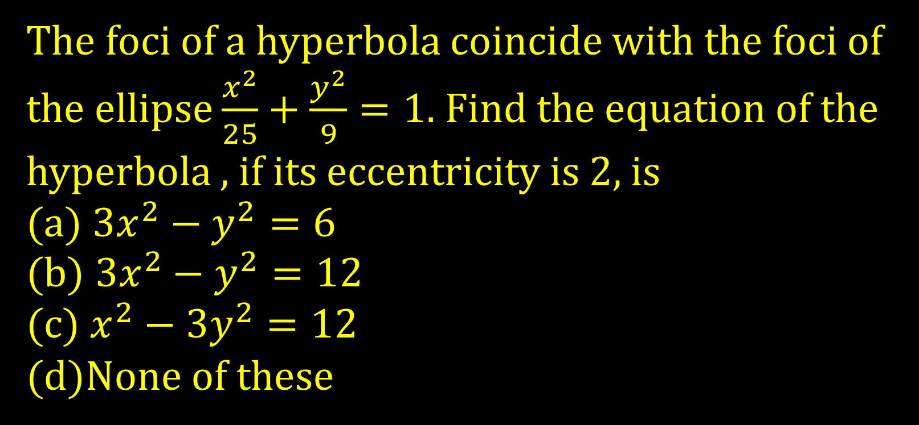
The foci of a hyperbola coincide with the foci of the ellipse $\frac{x^{2}}{25}+\frac{y^{2}}{9}=1.$ Find the equation of the hyperbola , if its eccentricity is 2, is
(a) $3x^{2}−y^{2}=6$
(b) $3x^{2}−y^{2}=12$
(c) $x^{2}−3y^{2}=12$
(d)None of these

Slide 12
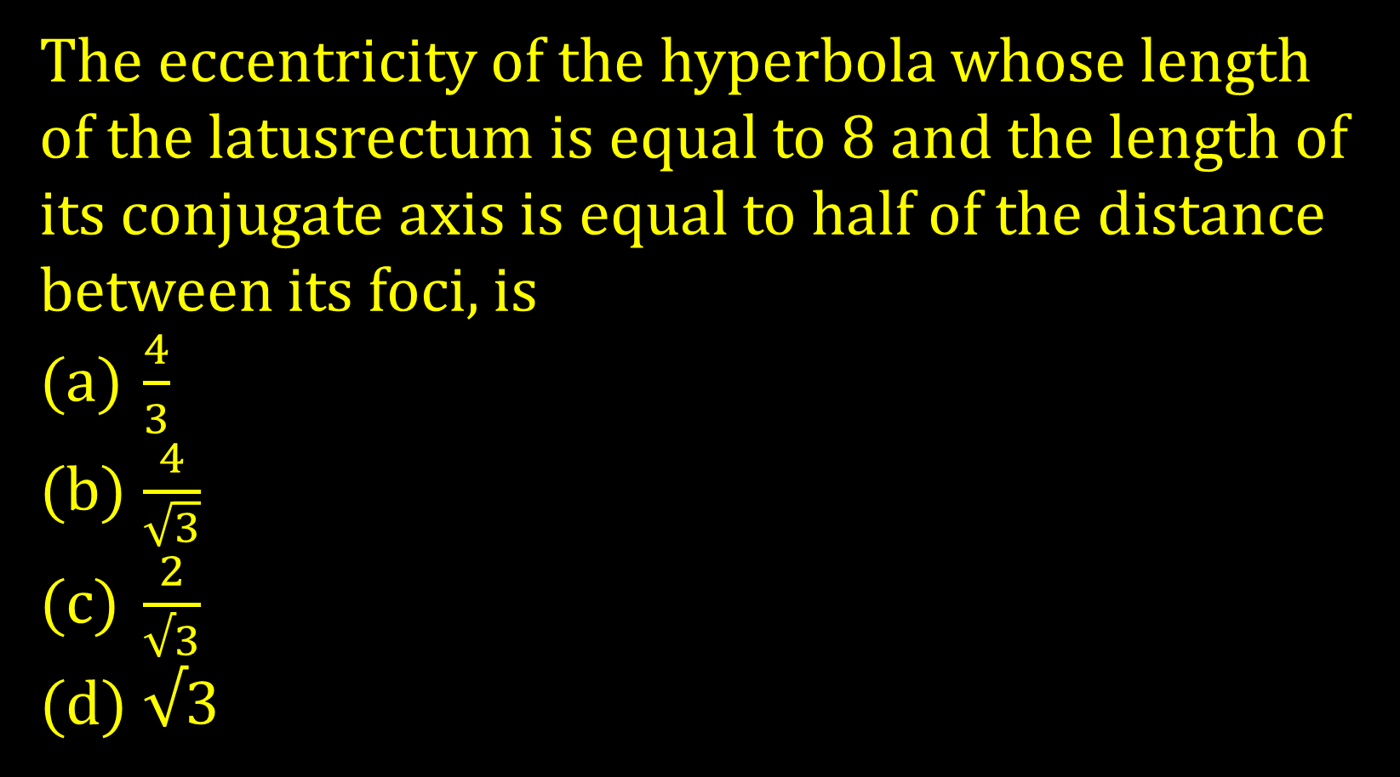
The eccentricity of the hyperbola whose length of the latusrectum is equal to 8 and the length of its conjugate axis is equal to half of the distance between its foci, is
$\frac{4}{3}$
$\frac{4}{\sqrt{3}}$
$\frac{2}{√3}$
$√$3

Slide 13
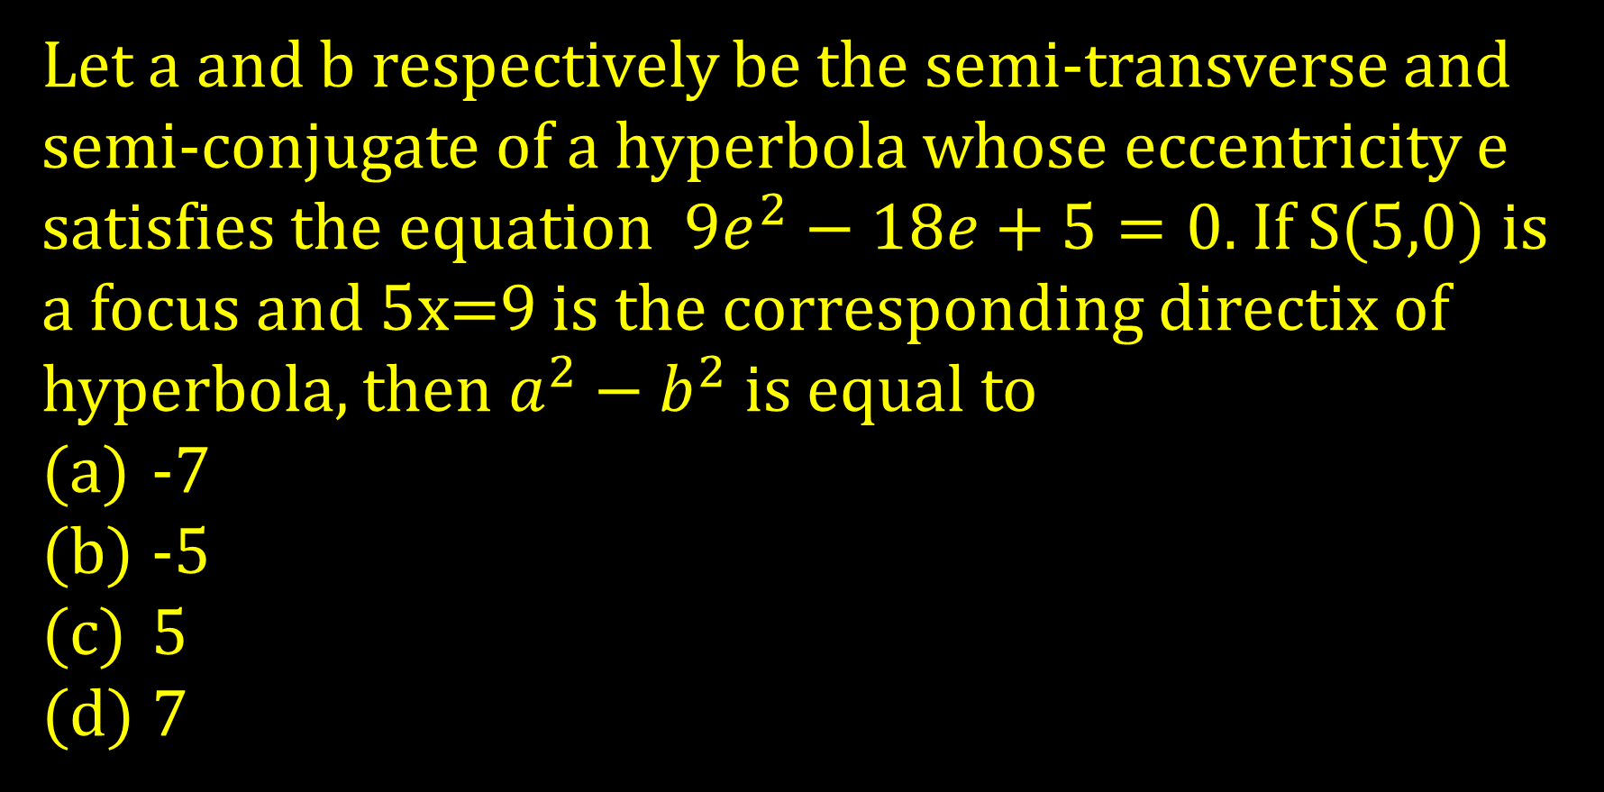
Let a and b respectively be the semi-transverse and semi-conjugate of a hyperbola whose eccentricity e satisfies the equation $9e^{2}−18e+5=0.$If S(5,0) is a focus and 5x=9 is the corresponding directix of hyperbola, then $a^{2}−b^{2}$is equal to
-7
-5
5
7

Slide 14
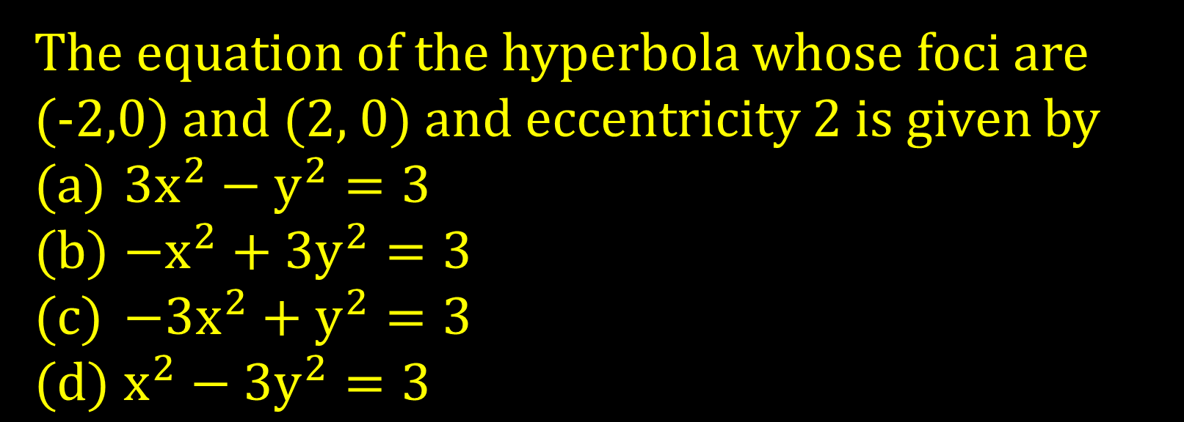
The equation of the hyperbola whose foci are
(-2,0) and (2, 0) and eccentricity 2 is given by
$3x^{2}−y^{2}=3$
$−x^{2}+3y^{2}=3$
$−3x^{2}+y^{2}=3$
$x^{2}−{3y}^{2}=3$

Slide 15
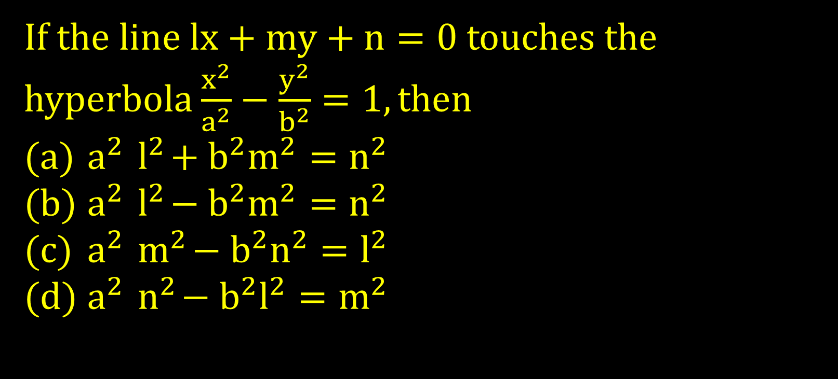
If the line $lx+my+n=0$ touches the hyperbola $\frac{x^{2}}{a^{2}}−\frac{y^{2}}{b^{2}}=1, then$
$a^{2}{ l}^{2}+b^{2}m^{2}=n^{2}$
$a^{2}{ l}^{2}−b^{2}m^{2}=n^{2}$
$a^{2}{ m}^{2}−b^{2}n^{2}=l^{2}$
$a^{2}{ n}^{2}−b^{2}l^{2}=m^{2}$

Slide 16
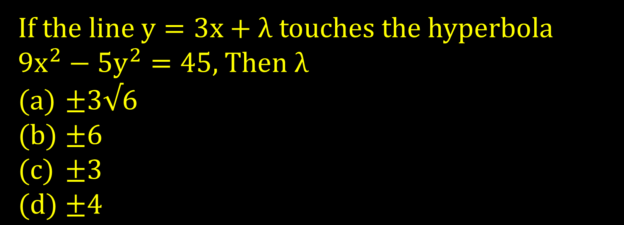
If the line $y=3x+λ$ touches the hyperbola $9x^{2}−5y^{2}=45,$Then $λ$
$±3√6$
$±6$
$±3$
$±4$

Slide 17
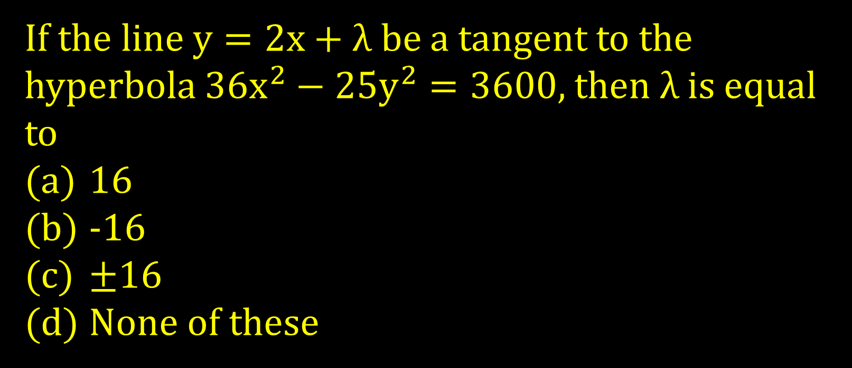
If the line $y=2x+λ$ be a tangent to the hyperbola $36x^{2}−25y^{2}=3600,$ then$λ$is equal to
16
-16
$±$16
None of these

Slide 18
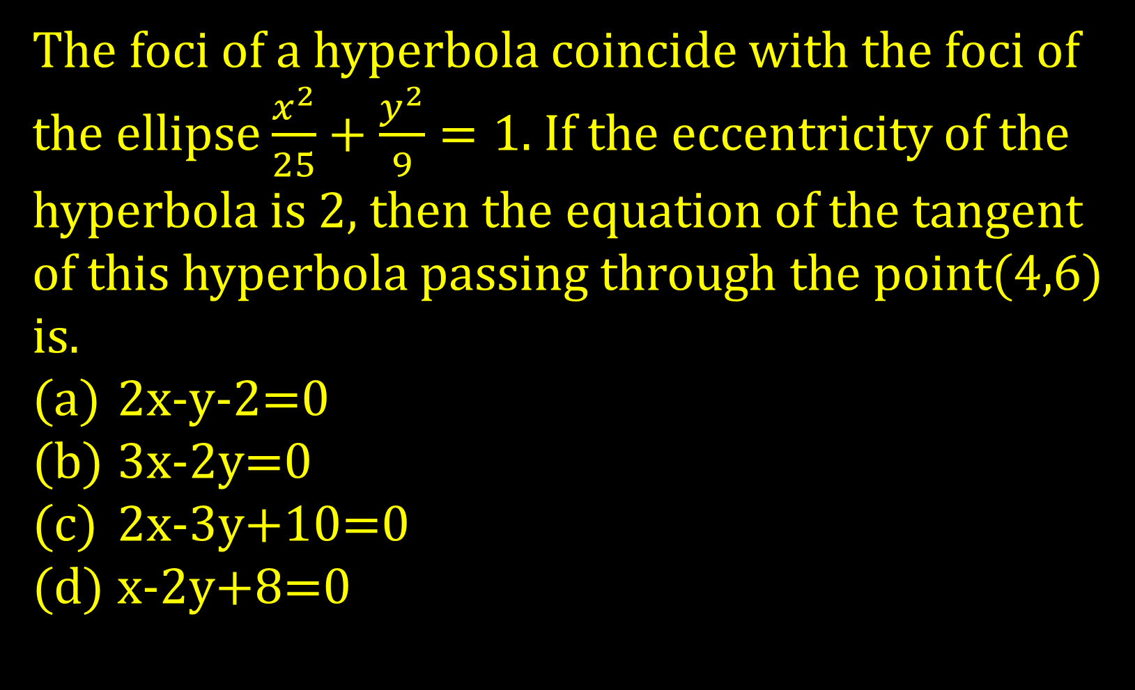
The foci of a hyperbola coincide with the foci of the ellipse $\frac{x^{2}}{25}+\frac{y^{2}}{9}=1$. If the eccentricity of the hyperbola is 2, then the equation of the tangent of this hyperbola passing through the point(4,6)
is.
2x-y-2=0
3x-2y=0
2x-3y+10=0
x-2y+8=0

Slide 19
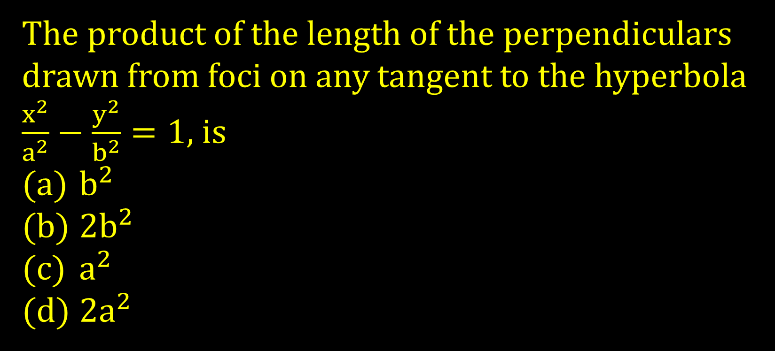
The product of the length of the perpendiculars drawn from foci on any tangent to the hyperbola $\frac{x^{2}}{a^{2}}−\frac{y^{2}}{b^{2}}=1$, is
$b^{2}$
2$b^{2}$
$a^{2}$
2$a^{2}$

Slide 20
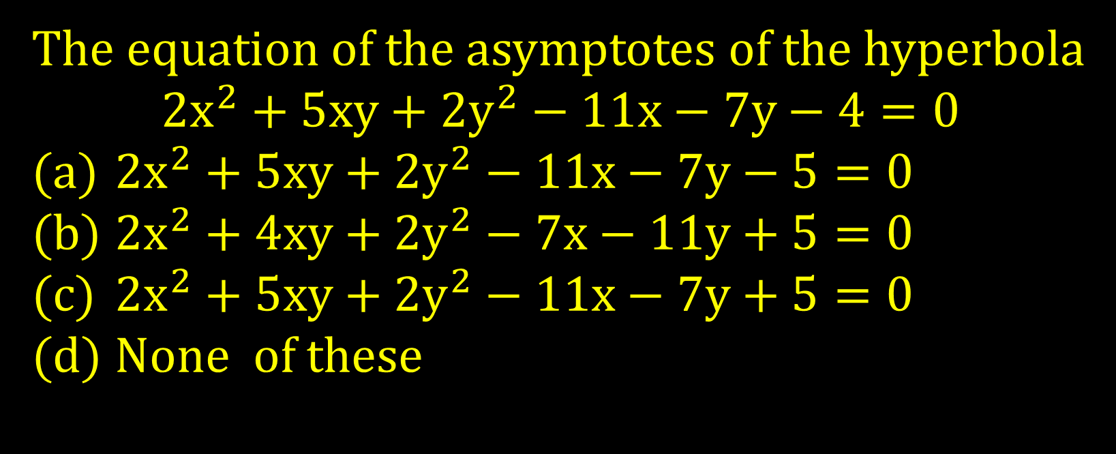
The equation of the asymptotes of the hyperbola
$$2x^{2}+5xy+2y^{2}−11x−7y−4=0$$
$2x^{2}+5xy+2y^{2}−11x−7y−5=0$
$2x^{2}+4xy+2y^{2}−7x−11y+5=0$
$2x^{2}+5xy+2y^{2}−11x−7y+5=0$
None of these

Slide 21
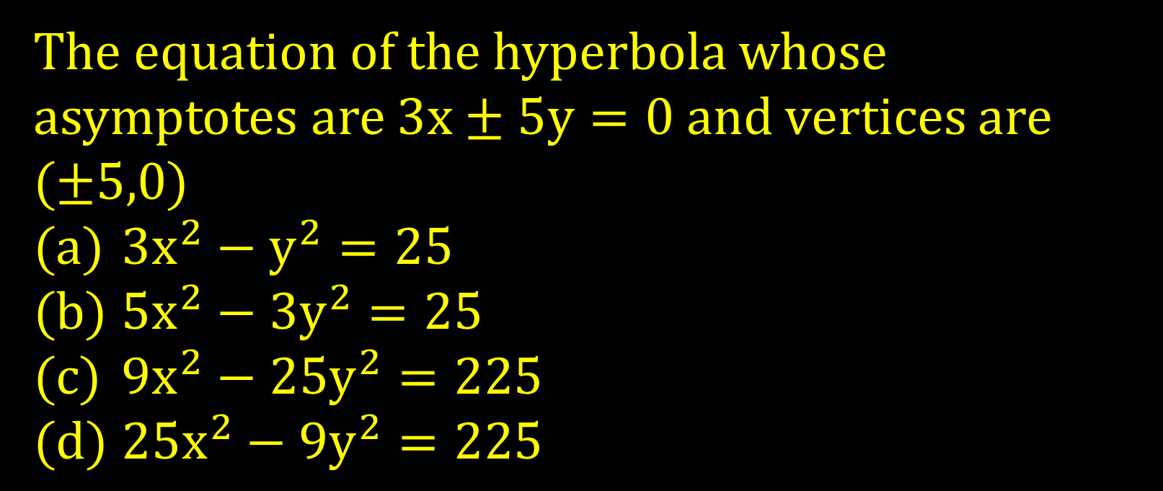
The equation of the hyperbola whose asymptotes are $3x±5y=0$ and vertices are ($±5,0$)
$3x^{2}−y^{2}=25$
$5x^{2}−3y^{2}=25$
$9x^{2}−25y^{2}=225$
$25x^{2}−9y^{2}=225$

Slide 22
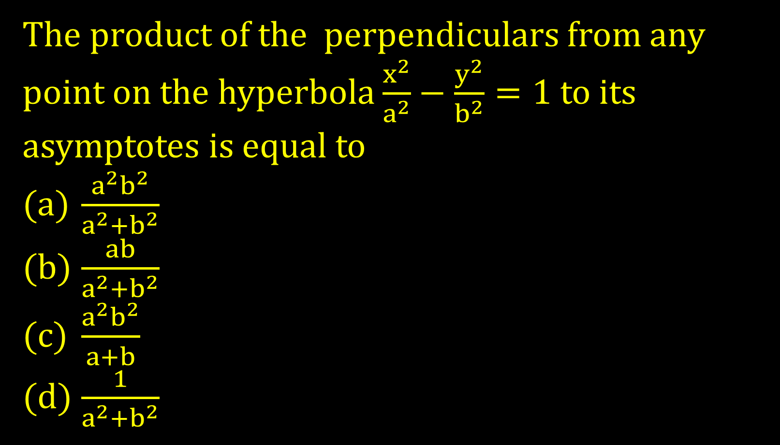
The product of the perpendiculars from any point on the hyperbola $\frac{x^{2}}{a^{2}}−\frac{y^{2}}{b^{2}}=1$to its asymptotes is equal to
$\frac{a^{2}b^{2}}{a^{2}+b^{2}}$
$\frac{ab}{a^{2}+b^{2}}$
$\frac{a^{2}b^{2}}{a+b}$
$\frac{1}{a^{2}+b^{2}}$

Slide 23
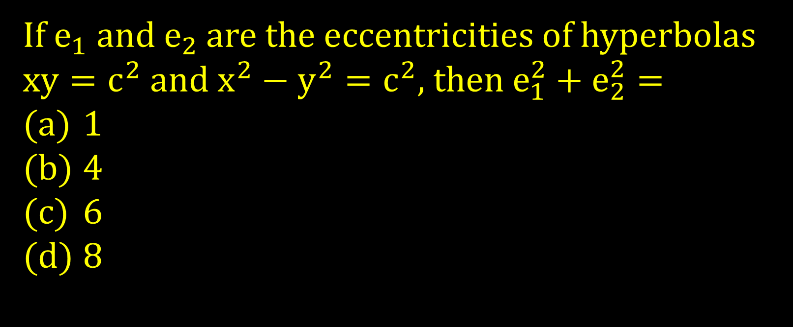
If $e_{1} and e_{2}$are the eccentricities of hyperbolas $xy=c^{2}$ and $x^{2}−y^{2}=c^{2}$, then $e_{1}^{2}+e_{2}^{2}=$
1
4
6
8

Slide 24
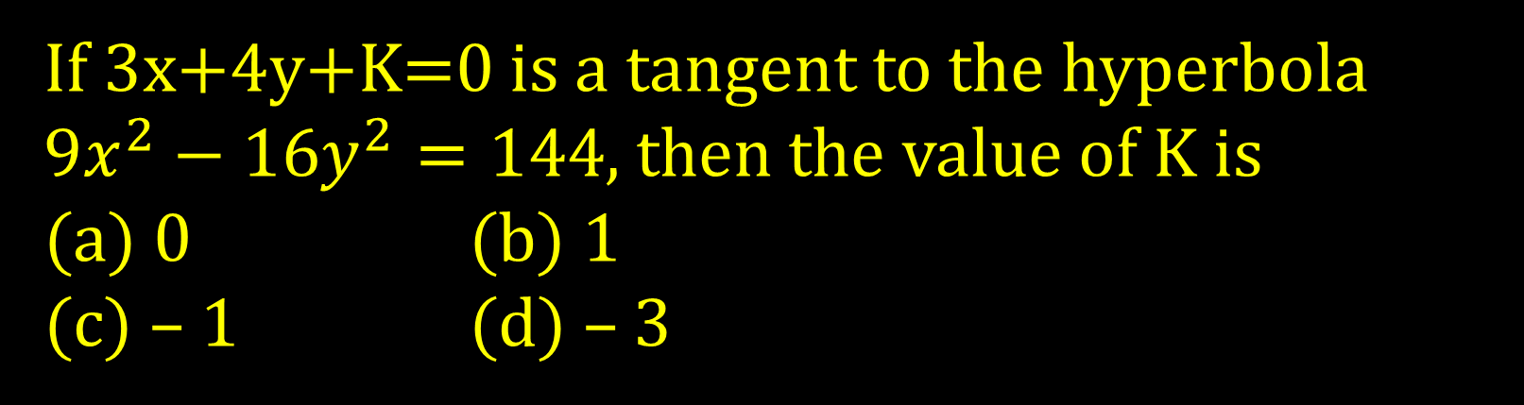
If 3x+4y+K=0 is a tangent to the hyperbola $9x^{2}−16y^{2}=144$, then the value of K is
(a) 0 (b) 1
(c) – 1 (d) – 3

Slide 25
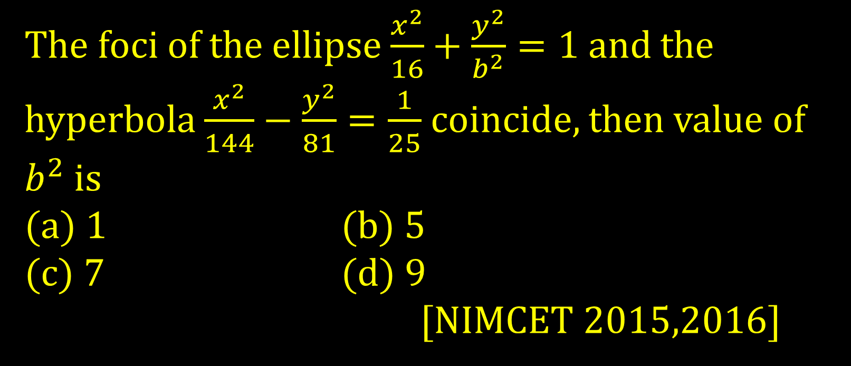
The foci of the ellipse $\frac{x^{2}}{16}+\frac{y^{2}}{b^{2}}=1$ and the hyperbola $\frac{x^{2}}{144}−\frac{y^{2}}{81}=\frac{1}{25}$ coincide, then value of $b^{2}$ is
(a) 1 (b) 5
(c) 7 (d) 9
[NIMCET 2015,2016]

Slide 26
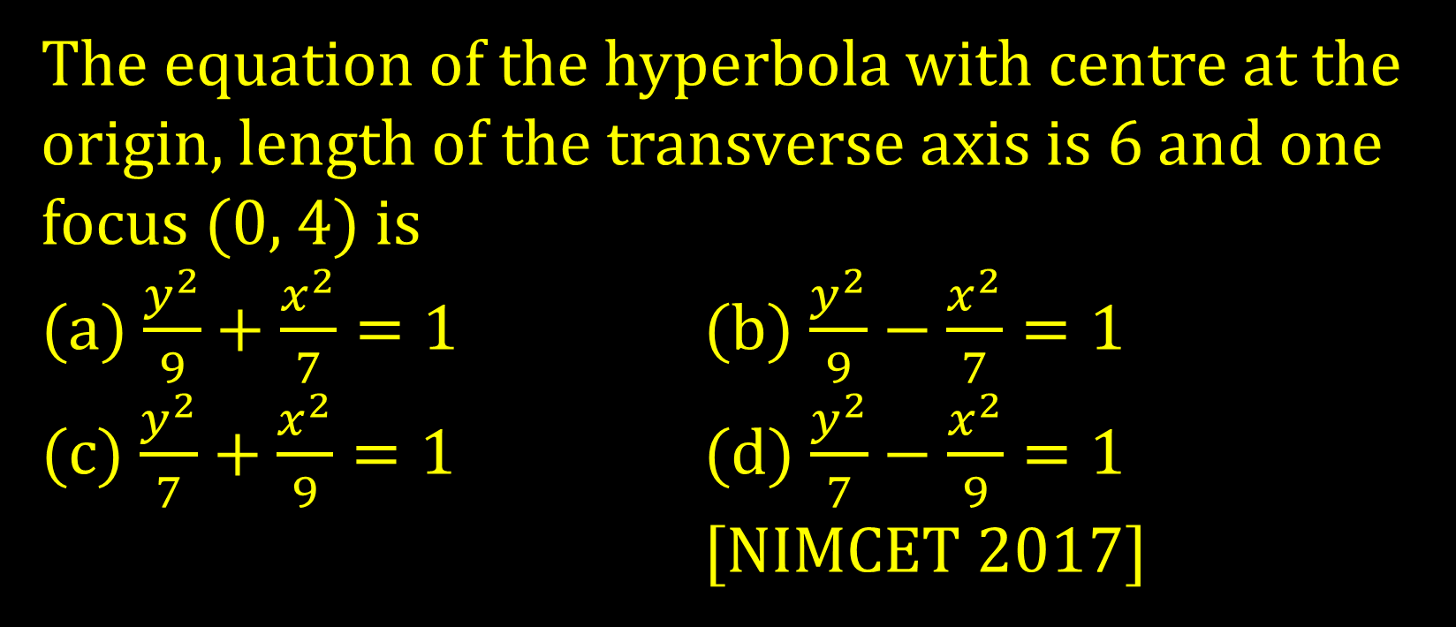
The equation of the hyperbola with centre at the origin, length of the transverse axis is 6 and one focus (0, 4) is
(a) $\frac{y^{2}}{9}+\frac{x^{2}}{7}=1$ (b) $\frac{y^{2}}{9}−\frac{x^{2}}{7}=1$
(c) $\frac{y^{2}}{7}+\frac{x^{2}}{9}=1$ (d) $\frac{y^{2}}{7}−\frac{x^{2}}{9}=1$
[NIMCET 2017]

Slide 27
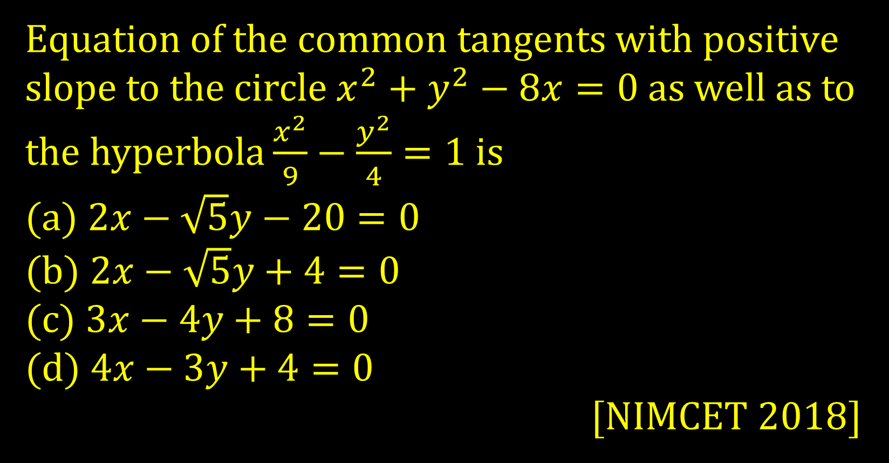
Equation of the common tangents with positive slope to the circle $x^{2}+y^{2}−8x=0$ as well as to the hyperbola $\frac{x^{2}}{9}−\frac{y^{2}}{4}=1$ is
(a) $2x−\sqrt{5}y−20=0$
(b) $2x−\sqrt{5}y+4=0$
(c) $3x−4y+8=0$
(d) $4x−3y+4=0$
[NIMCET 2018]

Slide 28
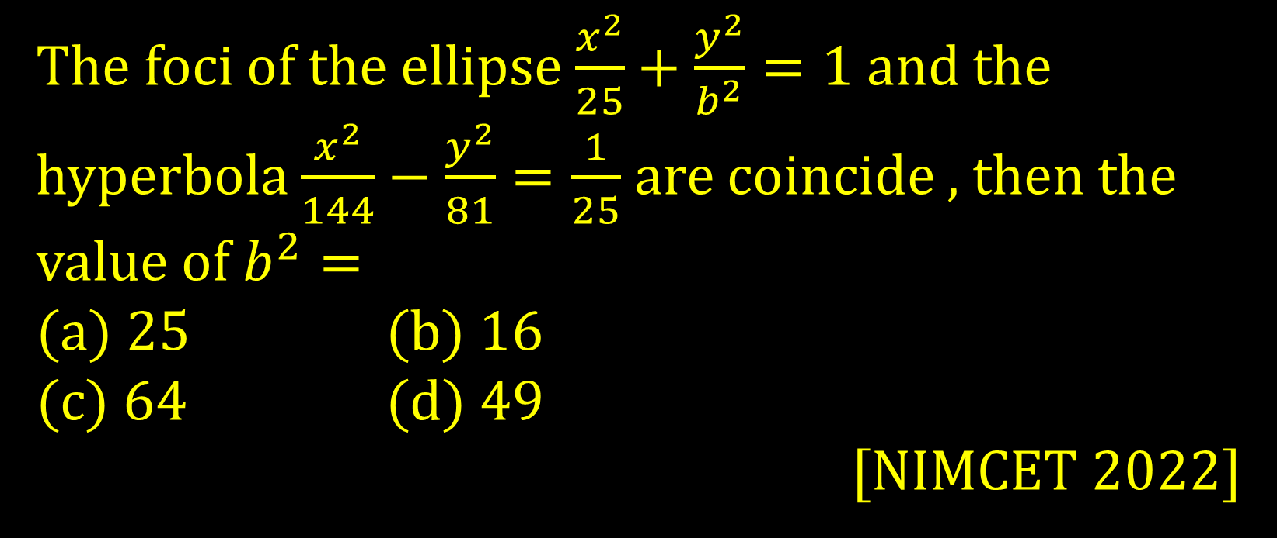
The foci of the ellipse $\frac{x^{2}}{25}+\frac{y^{2}}{b^{2}}=1$ and the hyperbola $\frac{x^{2}}{144}−\frac{y^{2}}{81}=\frac{1}{25}$ are coincide , then the value of $b^{2}=$
(a) 25 (b) 16
(c) 64 (d) 49
[NIMCET 2022]

